Slide 1
MY PROFILE PAGE
CHRIS MORRIS

Slide 2
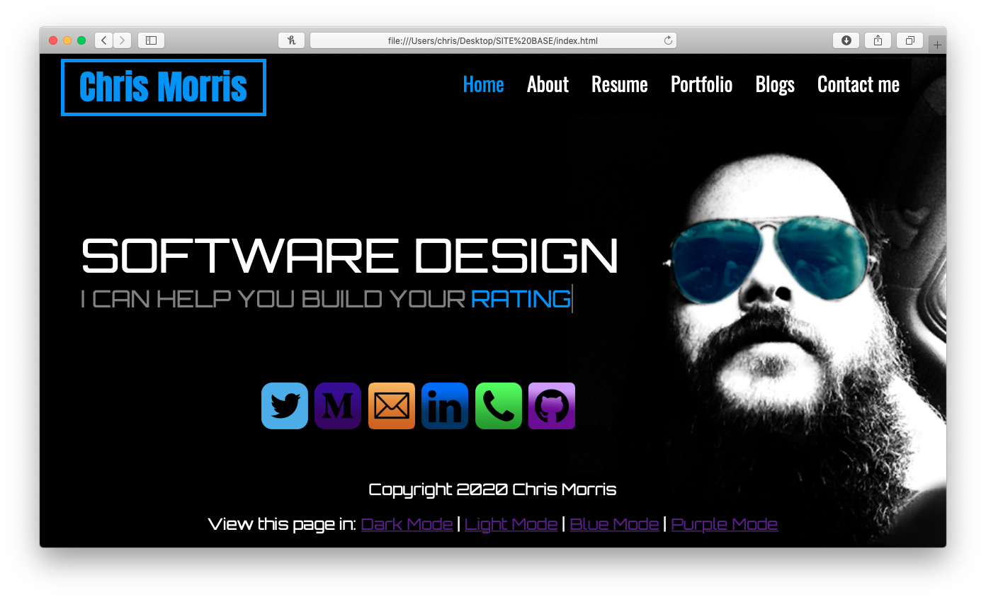

HOME PAGE
Writting that changes, that advertises what I can offer to the viewer
-Starting text: "I CAN HELP YOU BUILD YOUR" then the Changing text
-Changing text: "VISION", "CUSTOMERS", "TRAFFIC", "IMPACT", "RATING", "IMAGE", "PROFILE", "PROFIT"

Slide 3
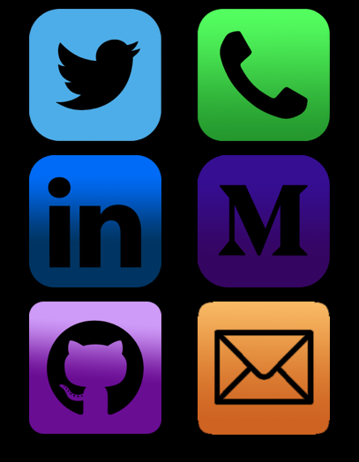
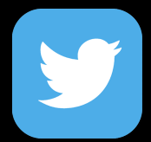
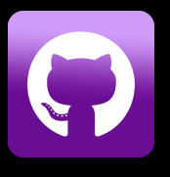
HOME PAGE and all others
Icons of all the diferent methods that the viewer can contact - Icons highlight white when hovered over
- Icons designed by myself and are bright to highlight them

Slide 4
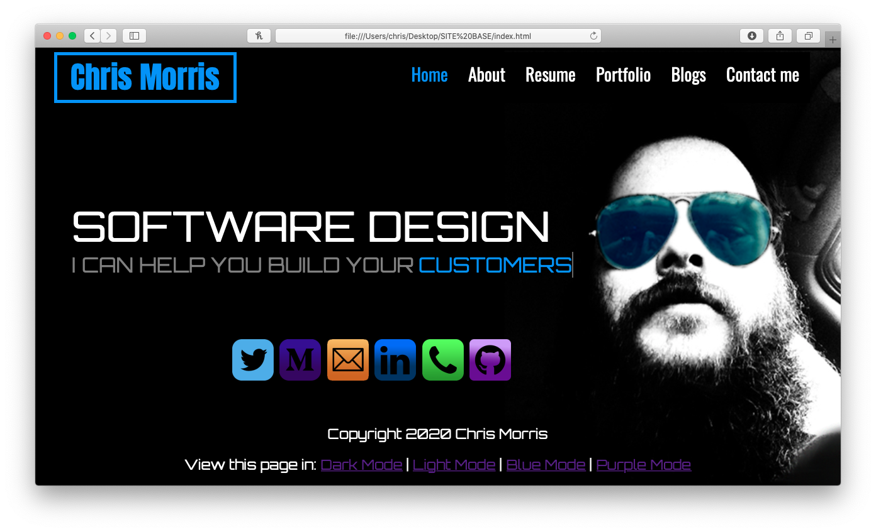
HOME PAGE
3. Background image
- This image background of
sets up the theme/mood of the page

Slide 5
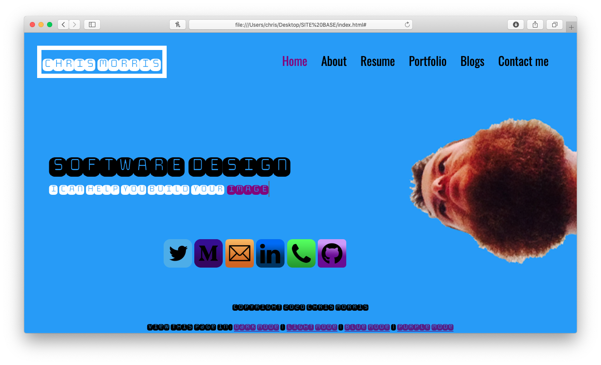
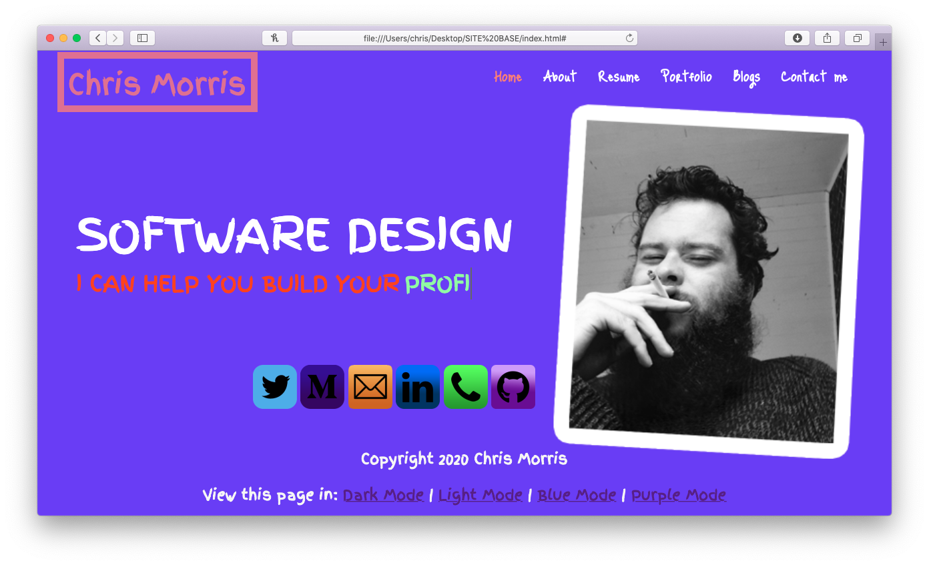
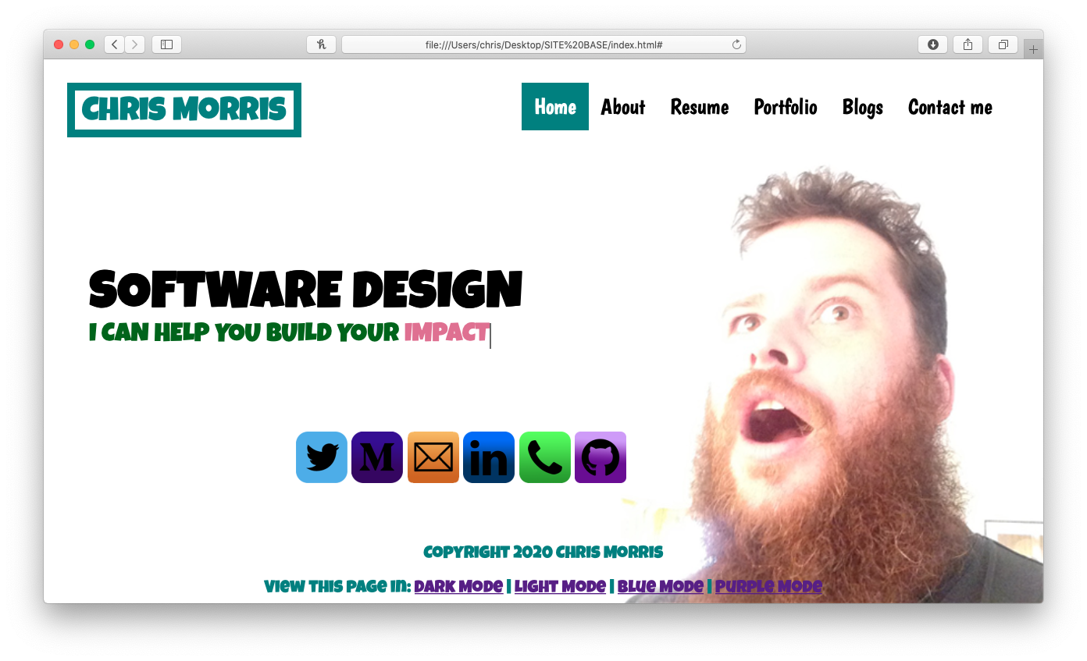

Slide 6
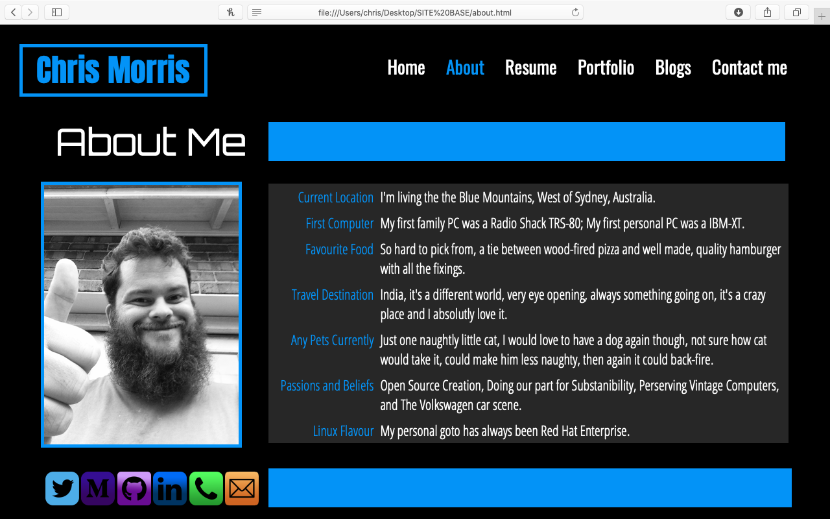
ABOUT PAGE
Picture of myself black and white
General Information about myself, my likes, things I do and my hobbies
Again: Icons of all the different methods that the viewer can contact

Slide 7
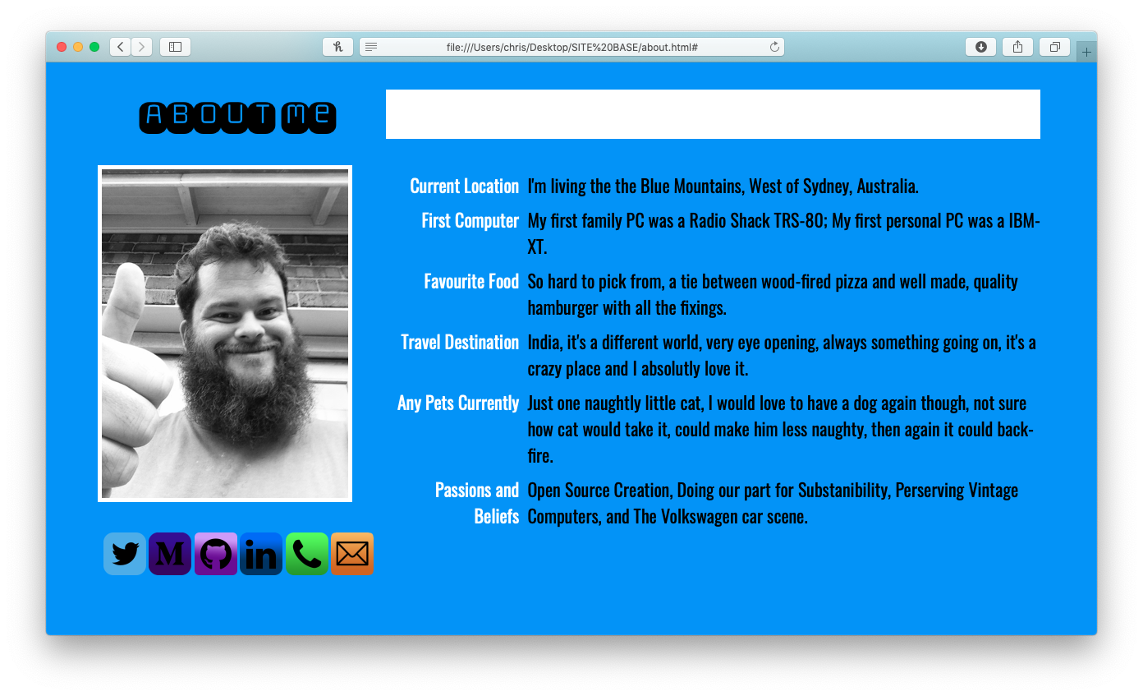
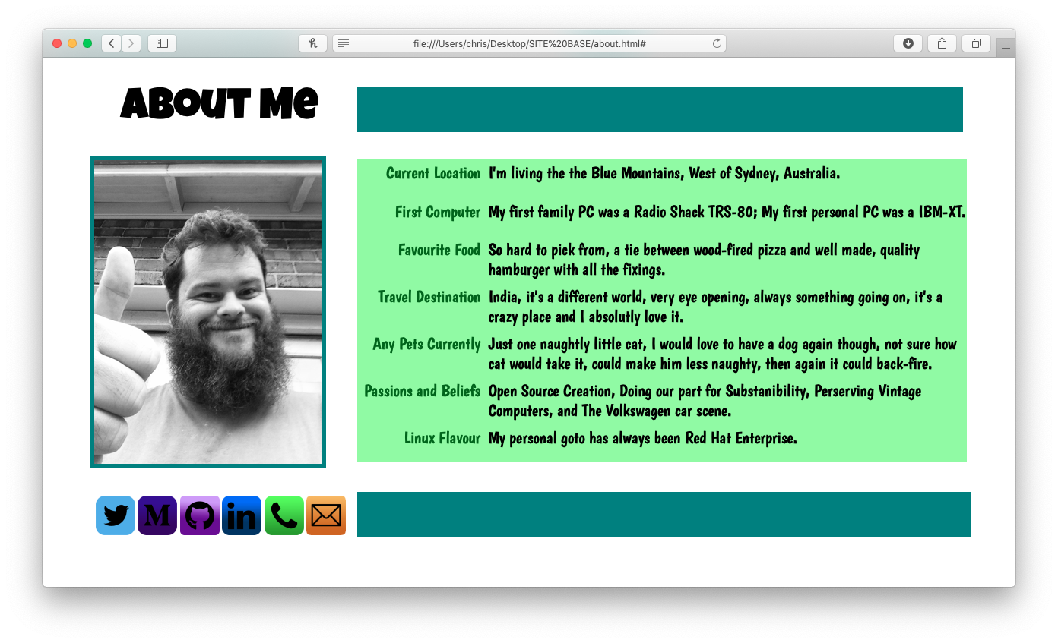
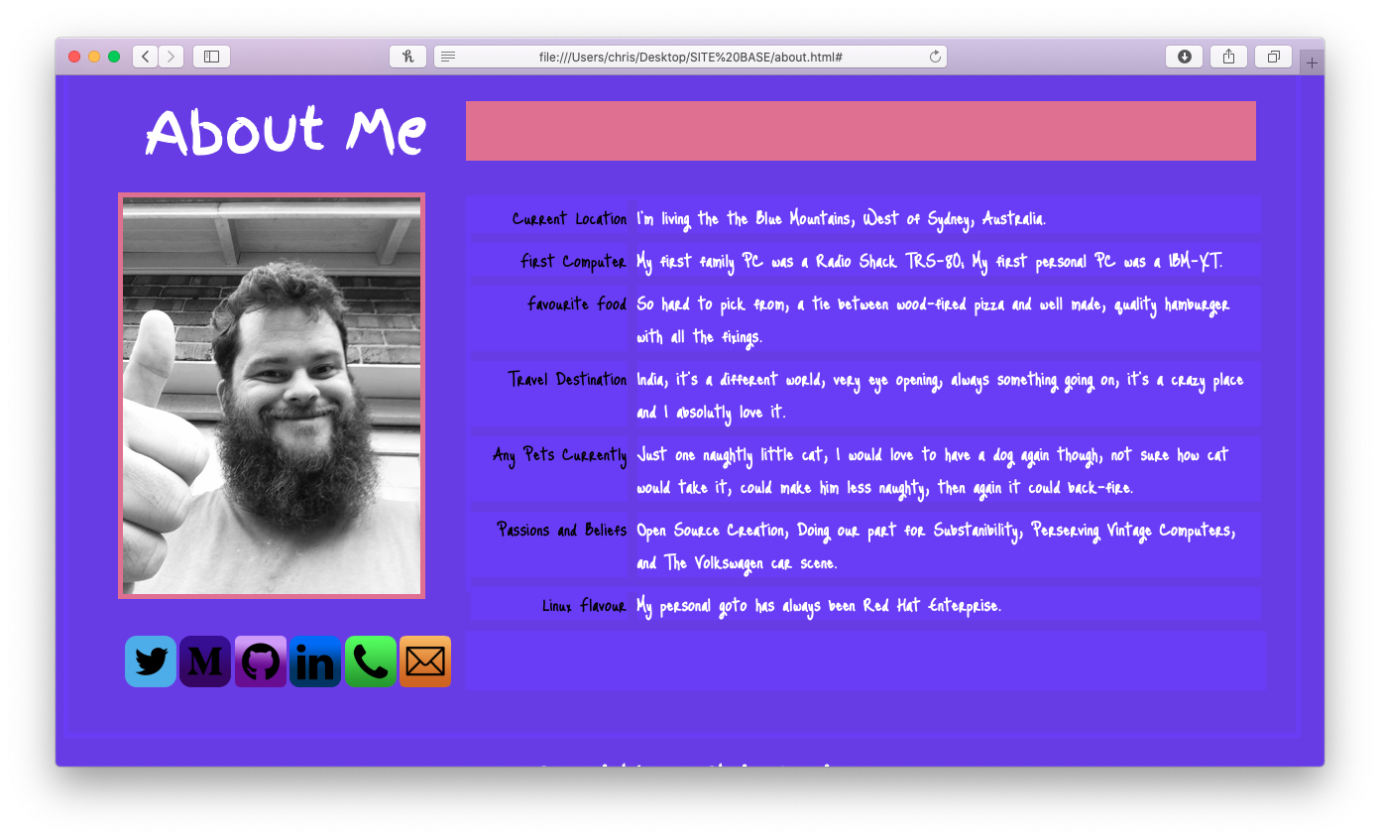

Slide 8
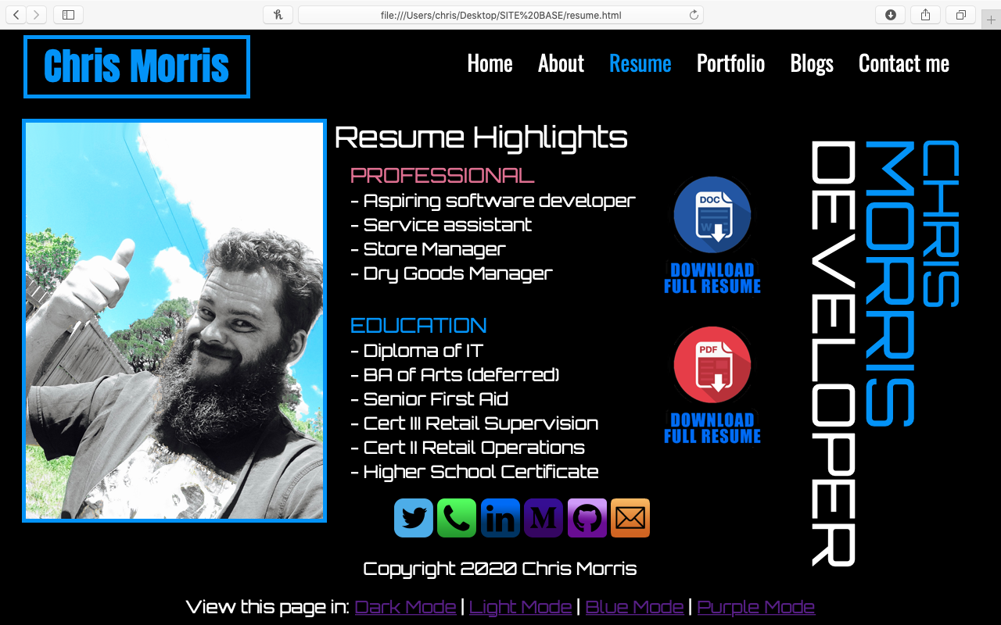
RESUME PAGE
Picture of myself, black and white but with a colour background to really stand out
Highlights from my resume, professional and education

Slide 9
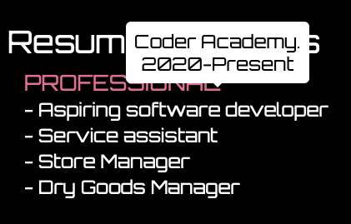
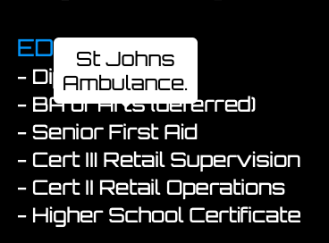
RESUME PAGE
- Hovering over the different points show a box with further information eg. hovering over 'Seinor first aid' gets a box displaying 'st johns ambulance', hover over 'aspiring software developer' a box displays 'Coder Academy 2020-Present'

Slide 10
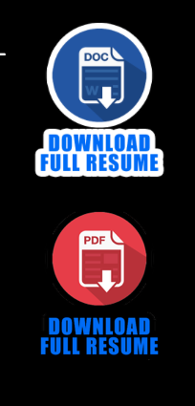
RESUME PAGE
Images customised my myself to highlight the full resume download links, hovering over them gives them a white background and really highlights them
Large sideways writting of my name to really stand out and sell myself

Slide 11
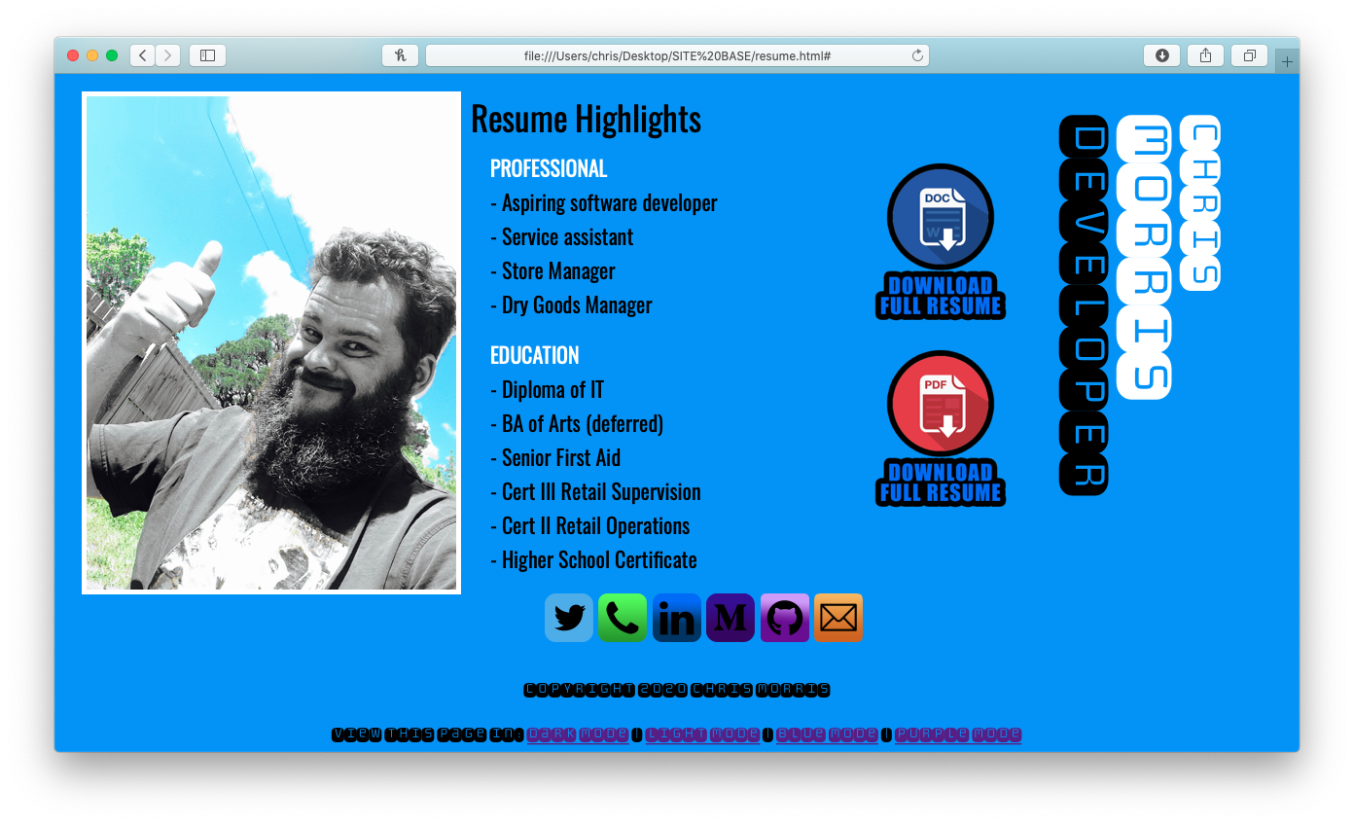
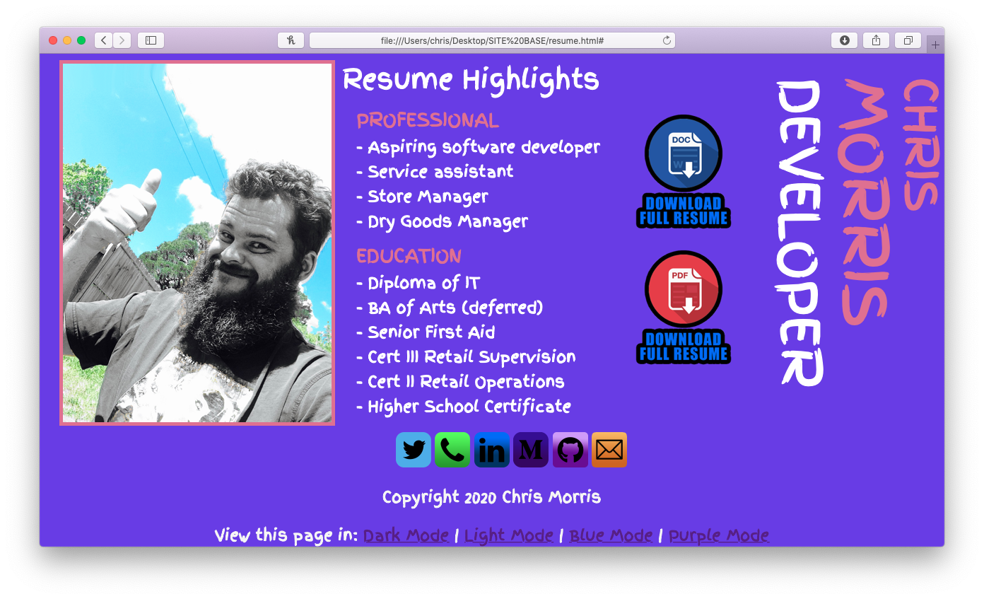
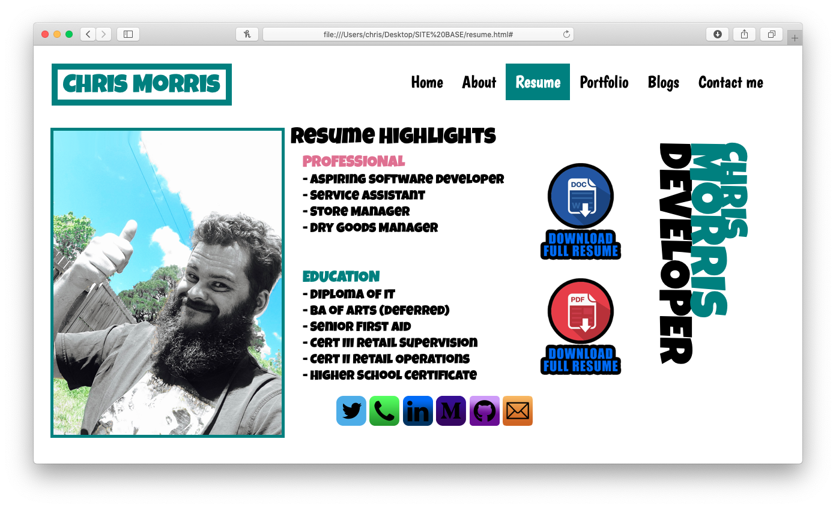

Slide 12
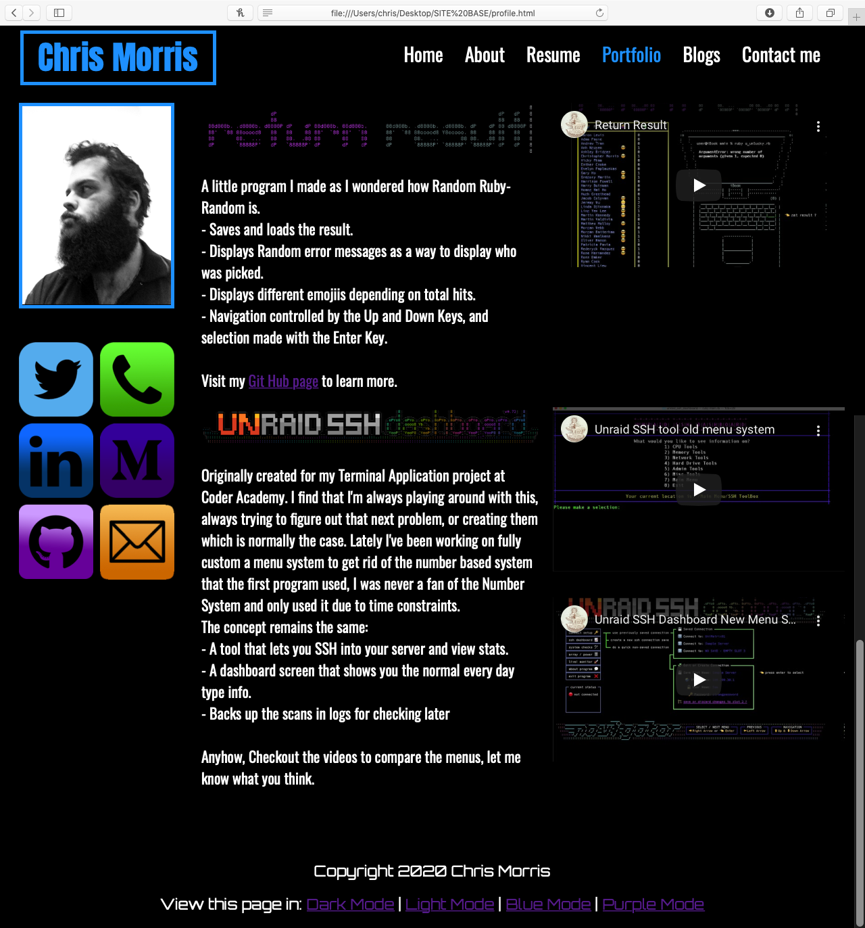

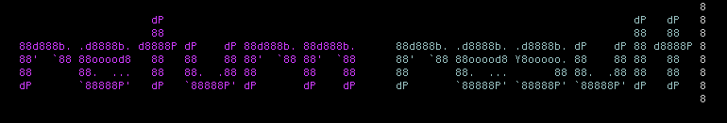
Portfolio Page
Picture of myself, black and white
3 different embedded you tube videos of the applications being used, showing their features
nformation and insight into both the applications
TITLES ARE THE LOGOS FROM THE APPS

Slide 13
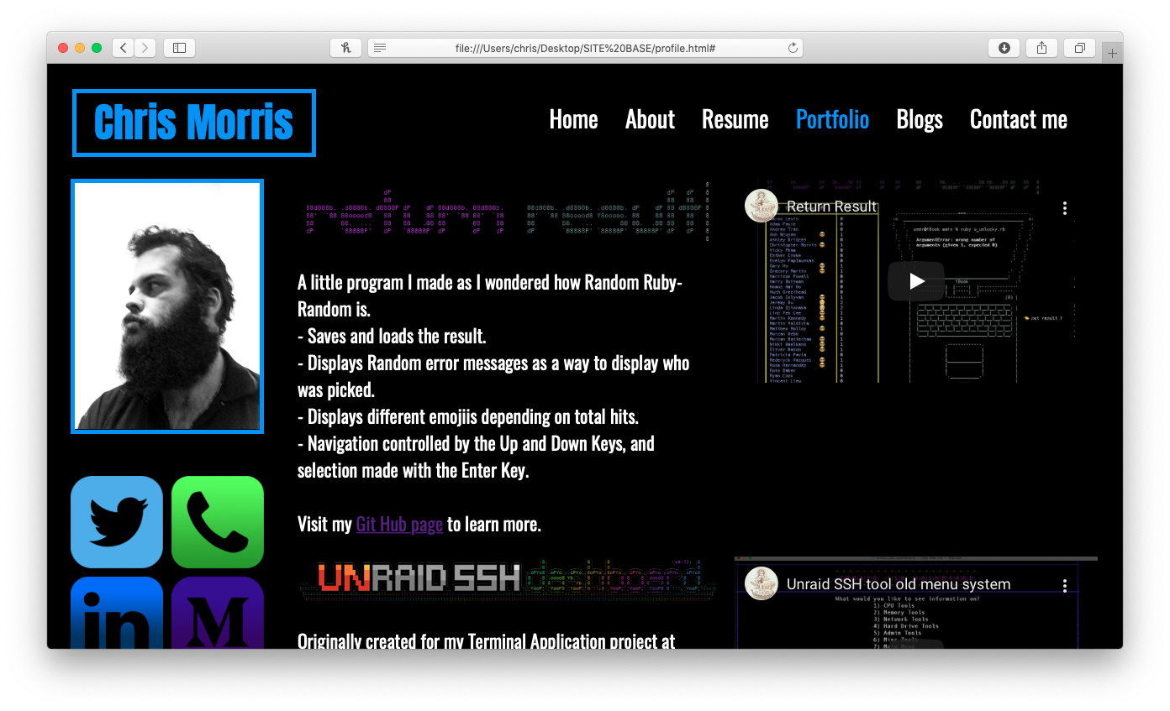
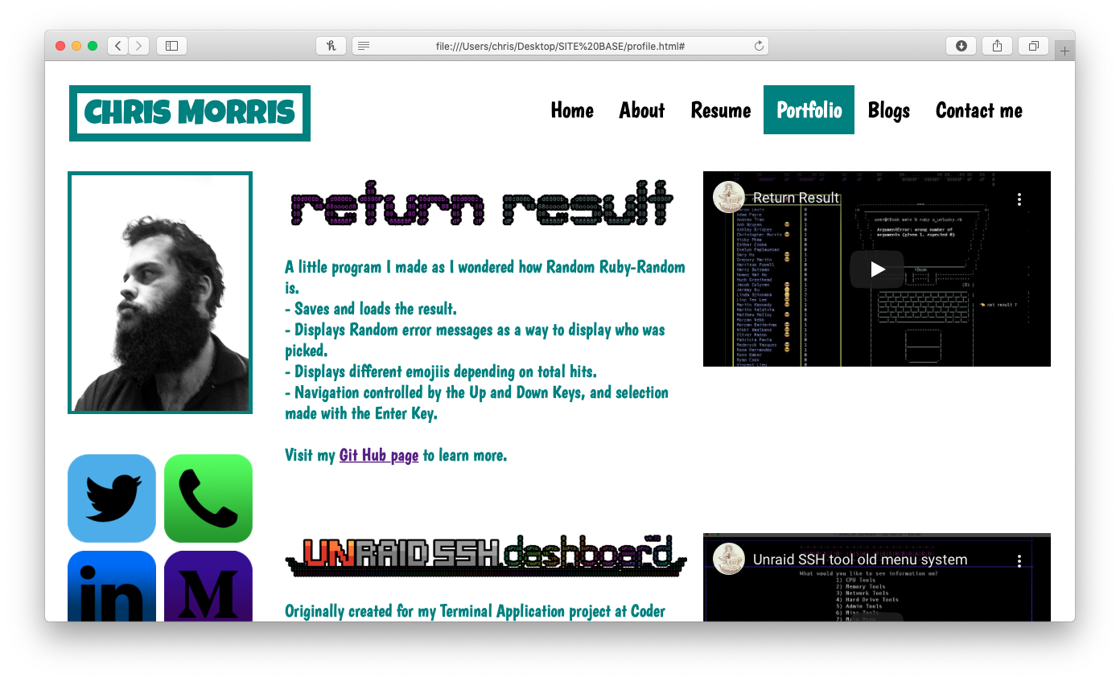
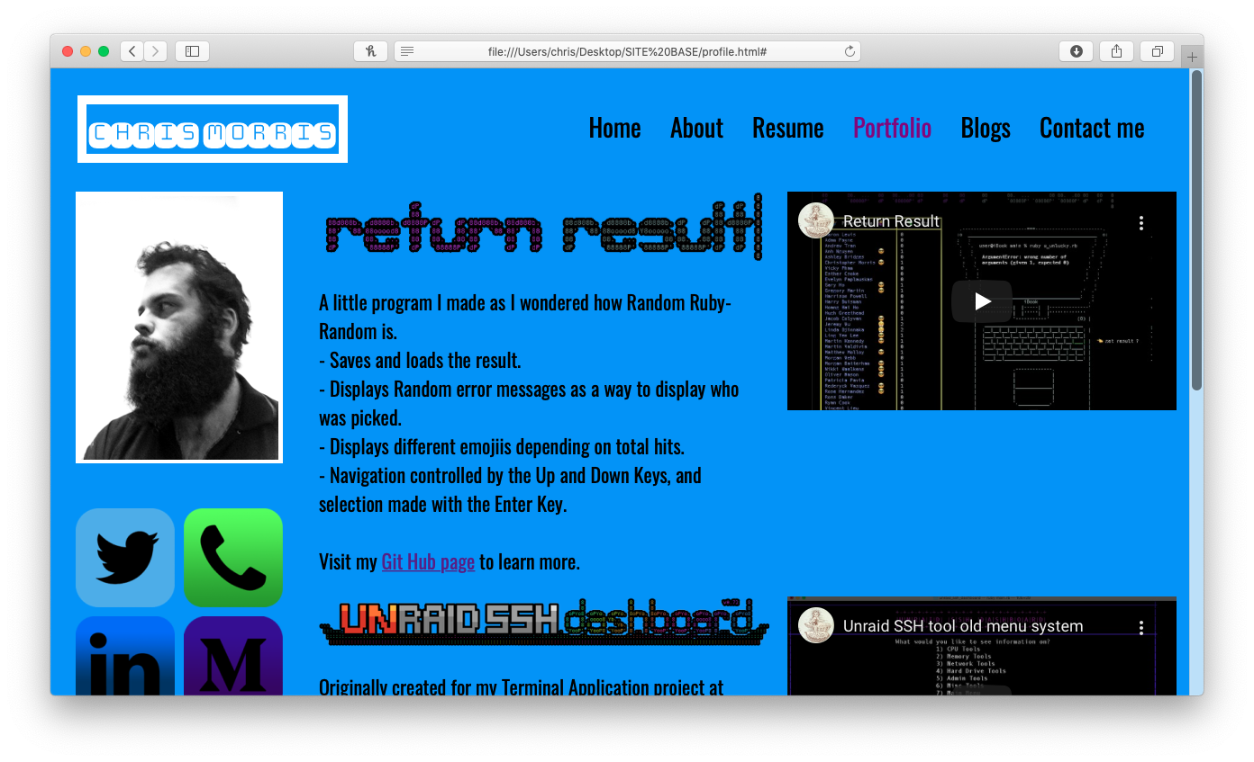
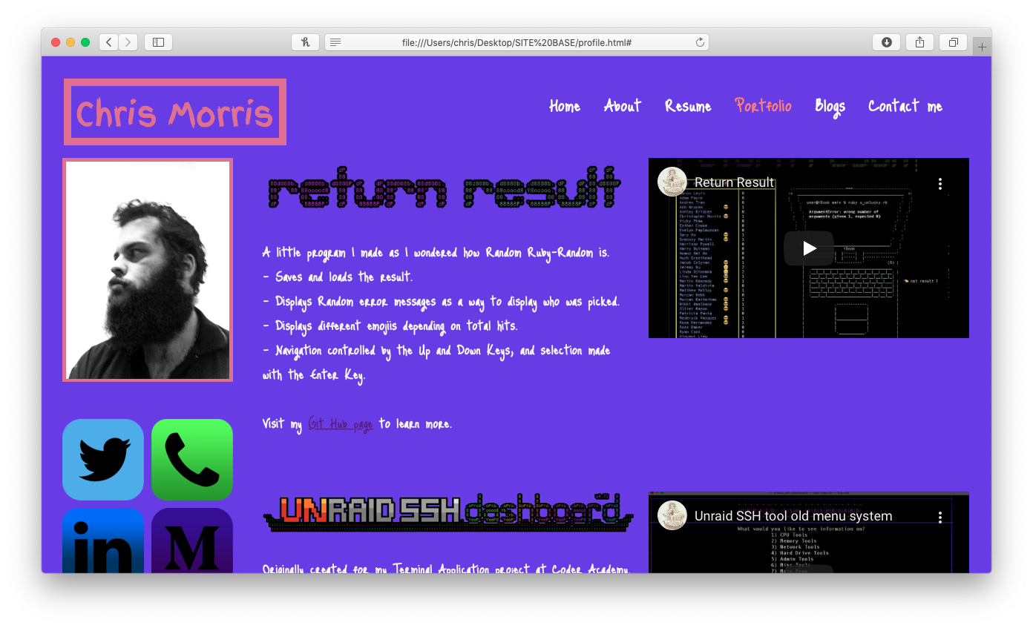

Slide 14
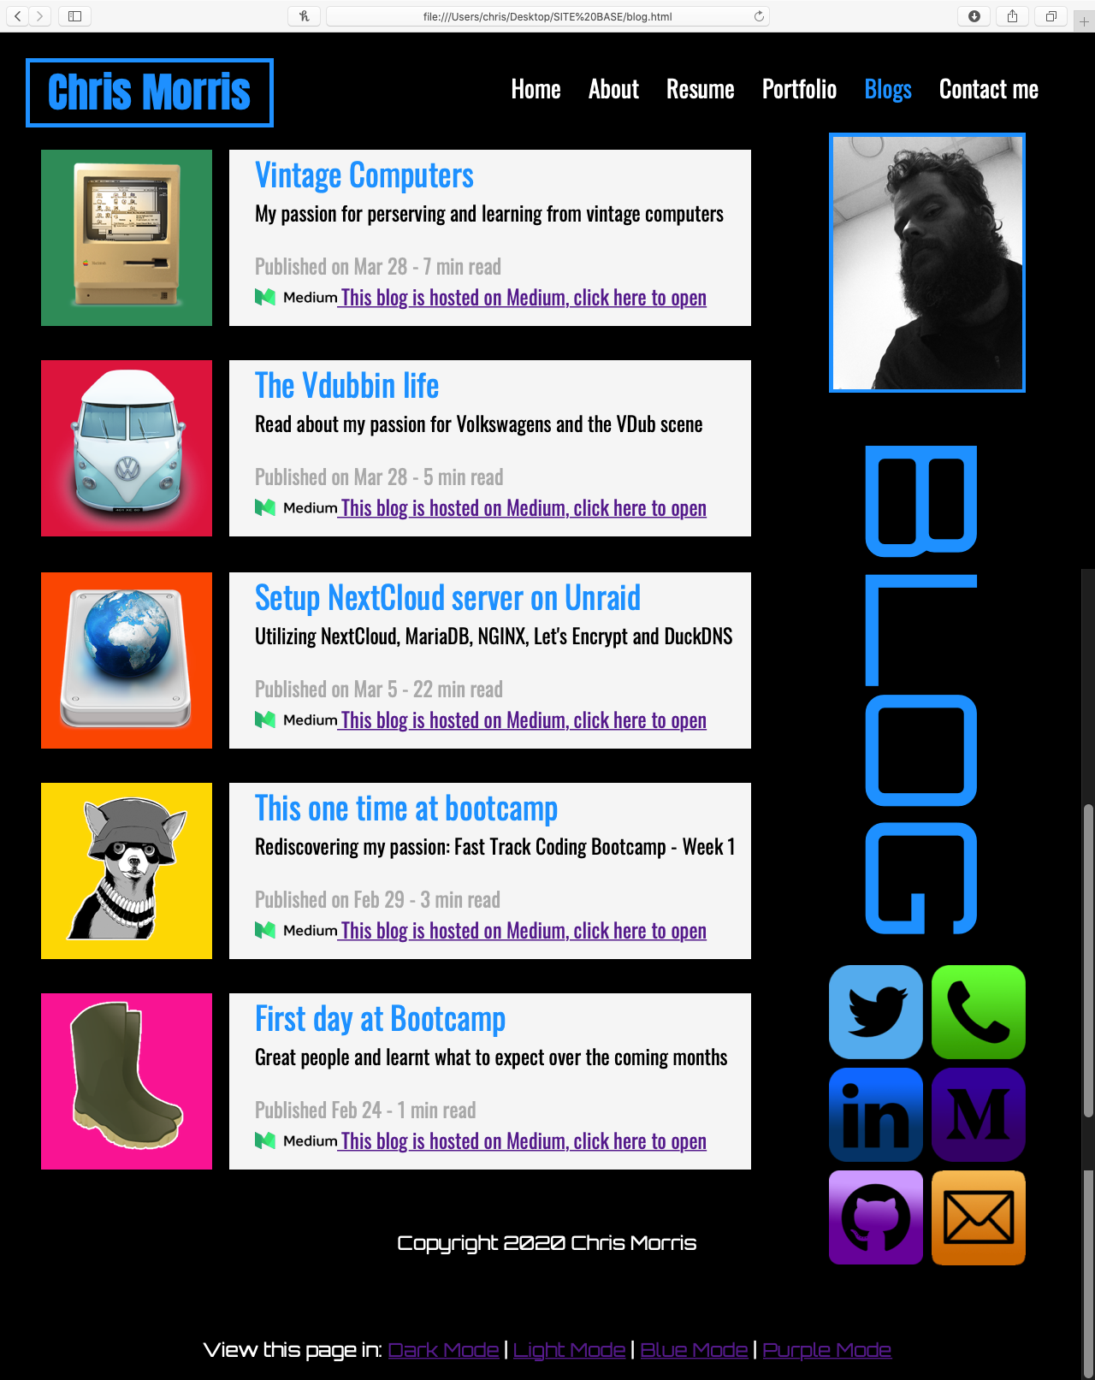
BLOG Page
Picture of myself, black and white
'Blogs' written sideways in large font to sell the page
All the blog information is seperated, with:
- Large icons with bright backgrounds to really stand out the different entieries.
- Large font of the blogs title
- Brief description
- Publish date and read time
- A link to that particular blog

Slide 15
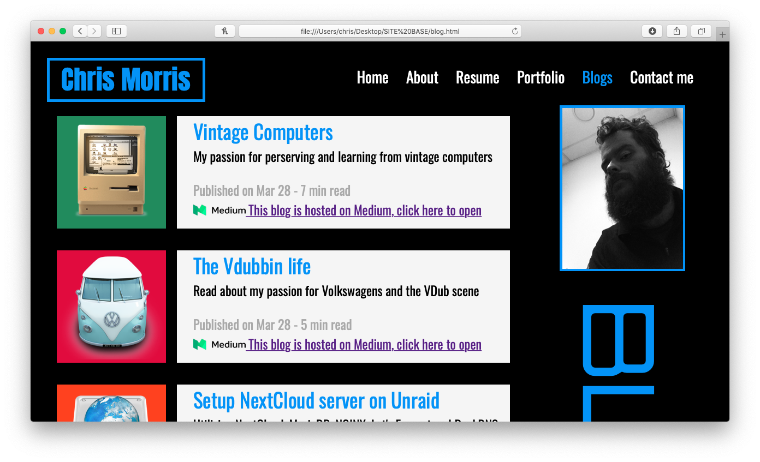
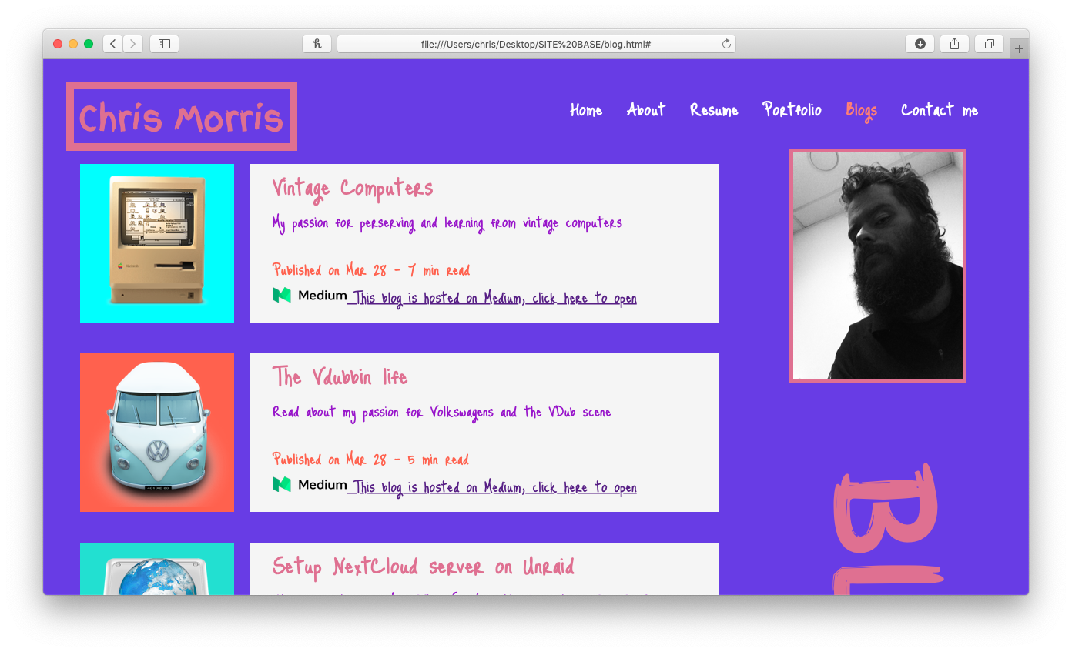
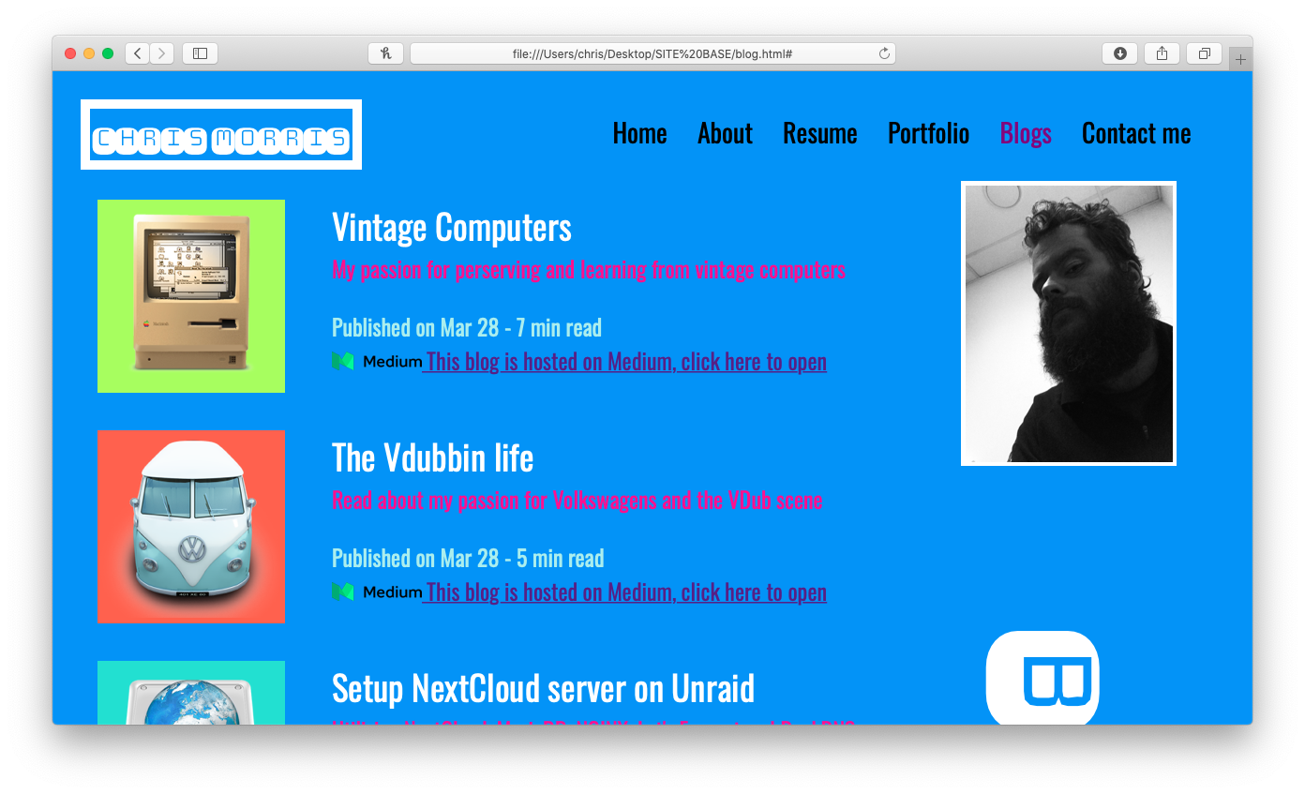
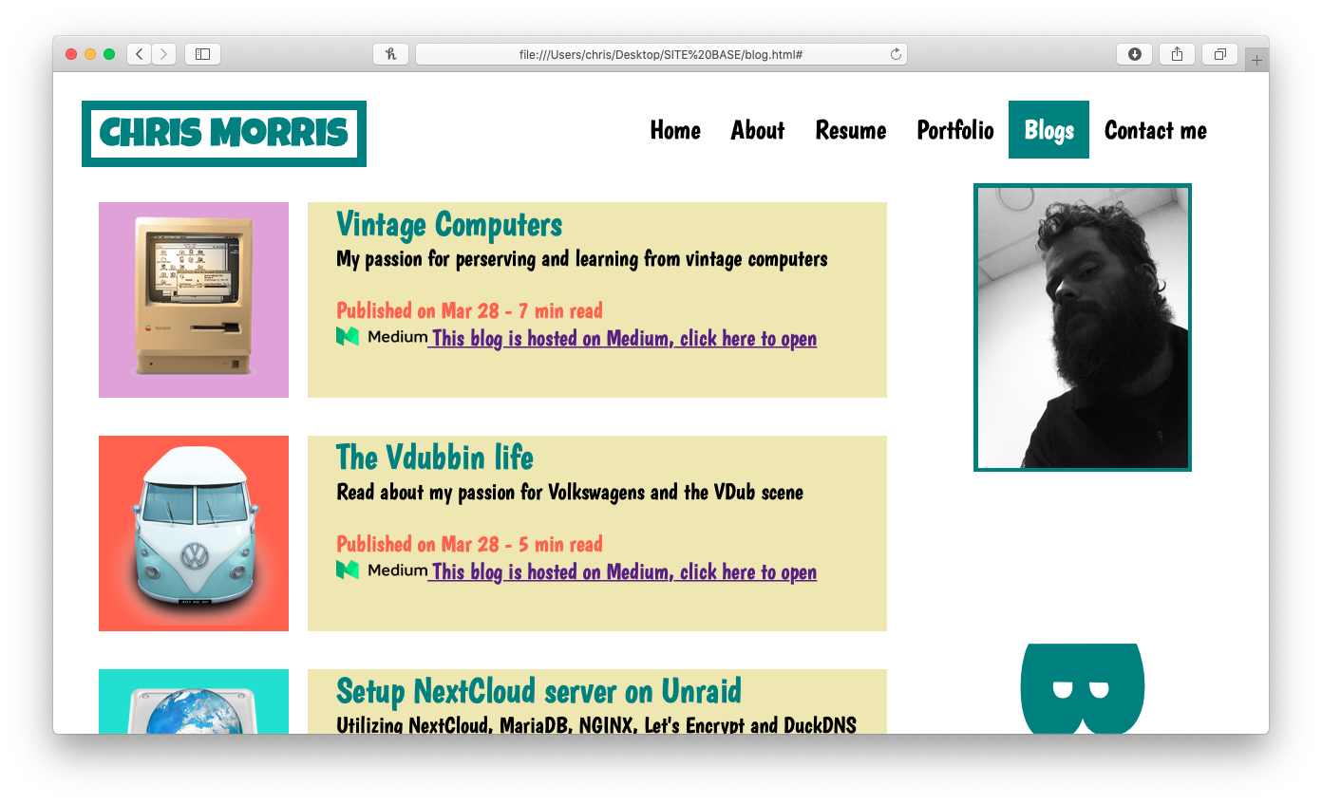

Slide 16
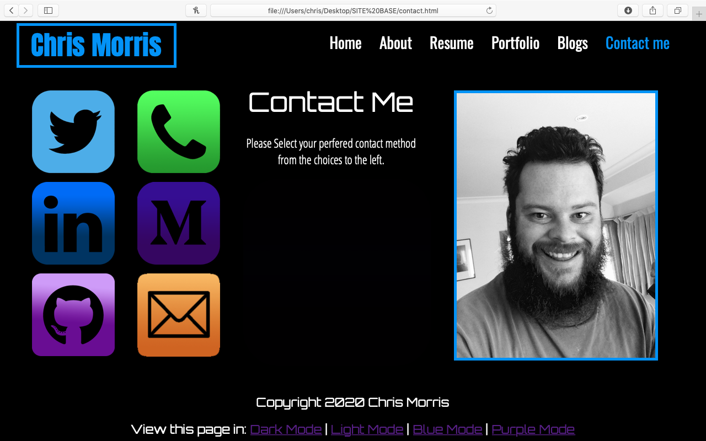
CONTACT ME PAGE
Icons of all the different methods that the viewer can contact
same as all other pages (highlight white when hovered over, designed bright to sell them) BUT this time a bit different:
- IIcons are much larger, supersized

Slide 17
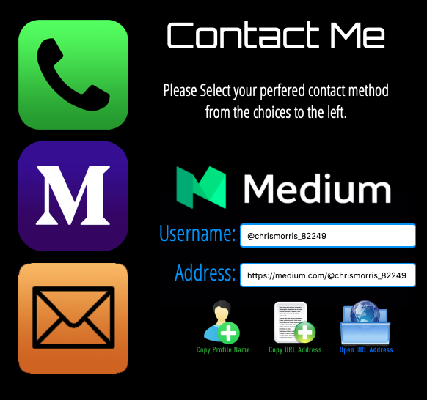
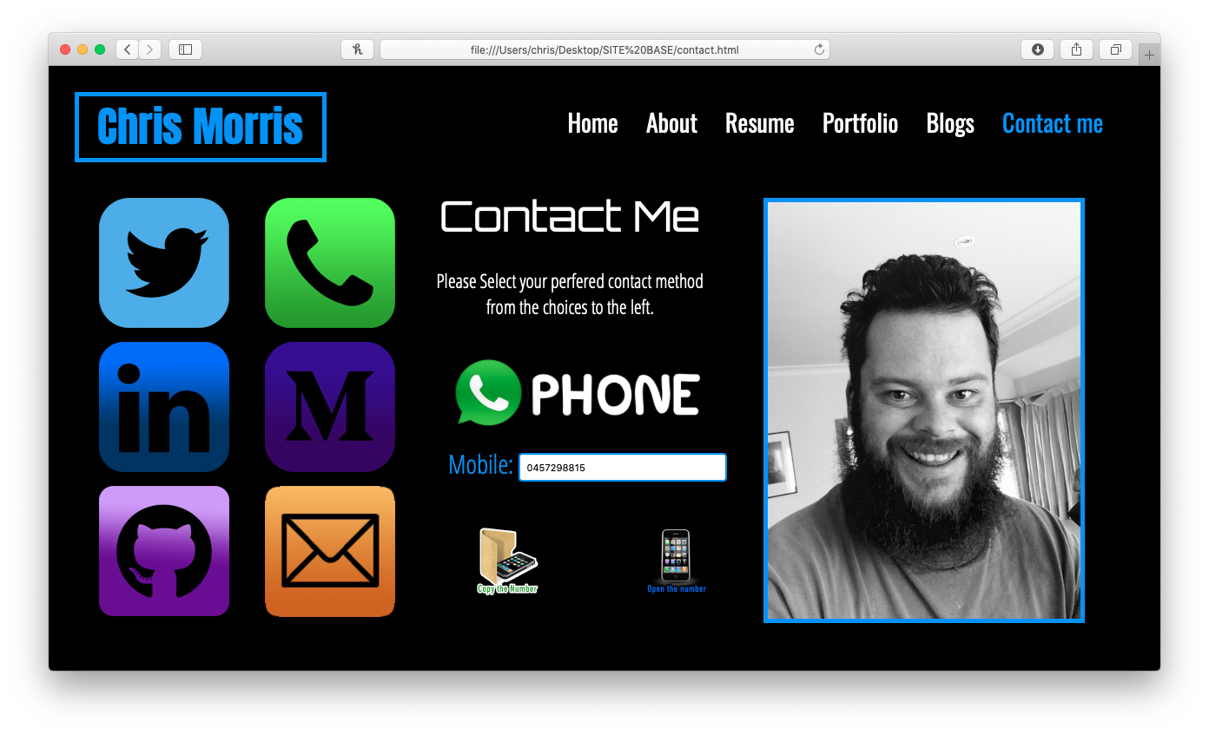
CONTACT ME PAGE
- Clicking on them brings up further information about that choice.
- Copy profile name to clipboard
- Copy URL to clipboard
- Open the URL

Slide 18
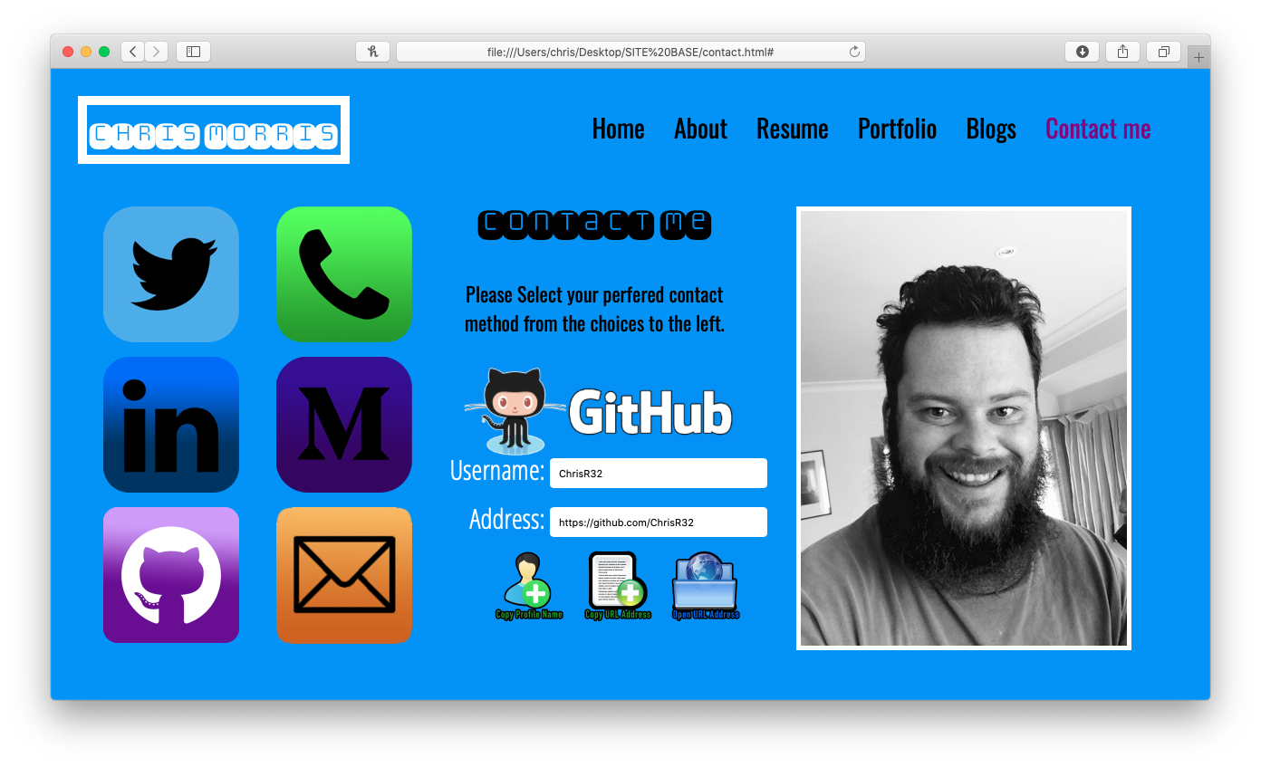
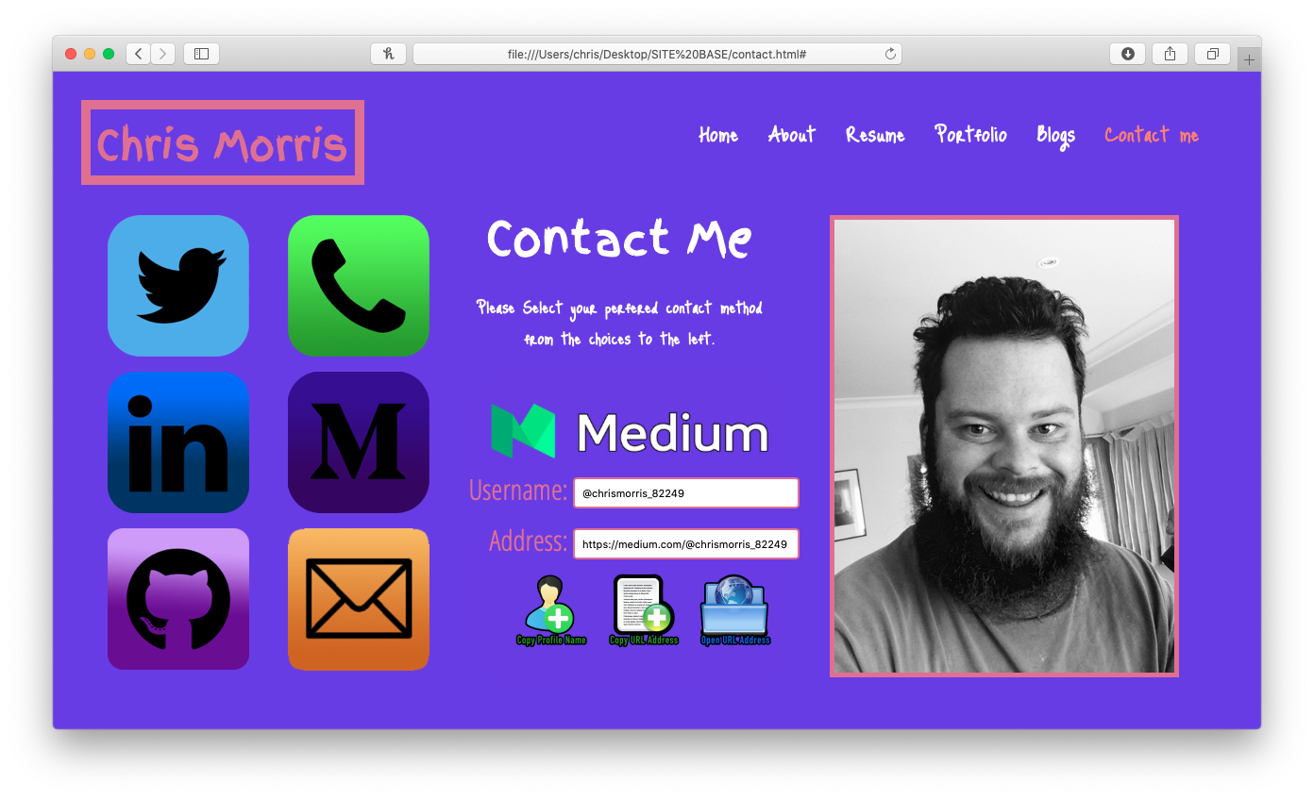
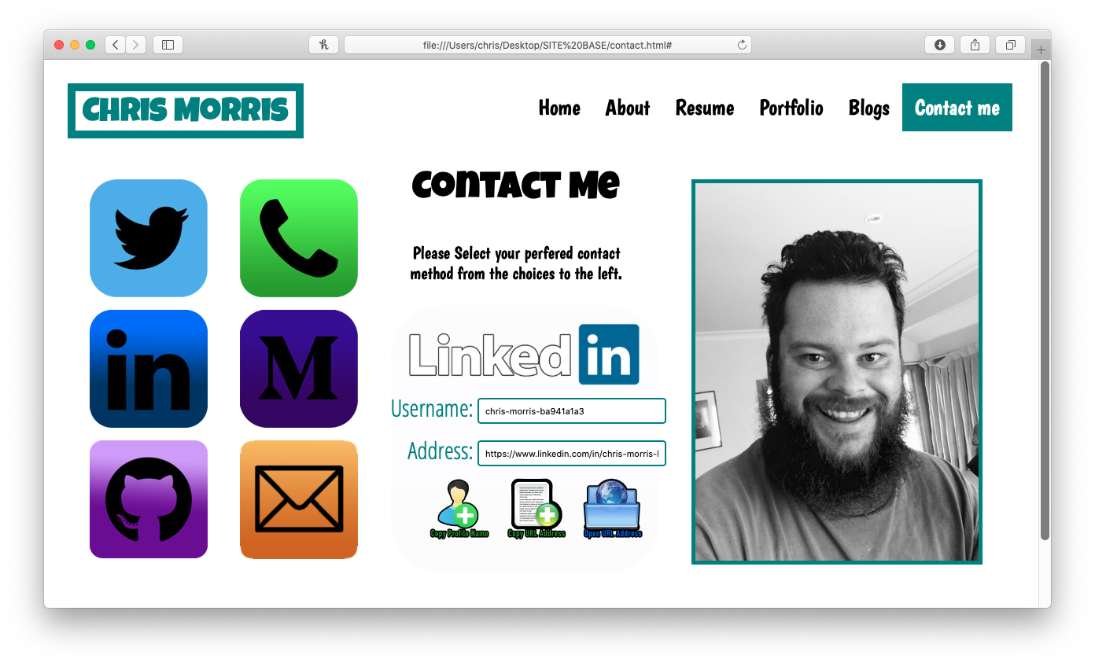
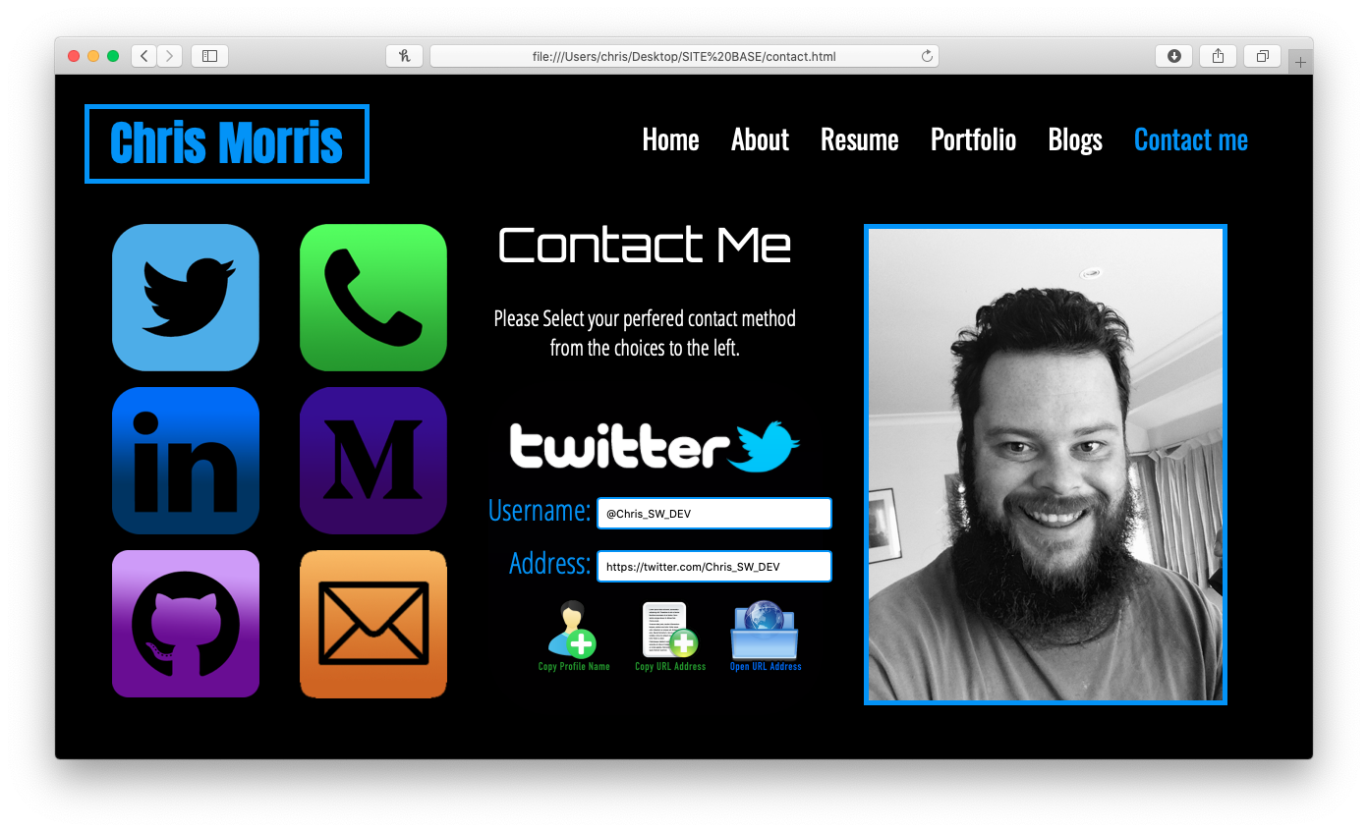

Slide 19
THE END

